Slide 1
機器學習應用於信用卡詐欺的績效評估
Performance evaluation of machine learning applications detecting credit card fraud
312707033包坤達、313707048郭奕伶
20240419 TEN MFS.key

Slide 2
Motivation
Data
Design of analysis
Empirucal results
Conclusion
IDA Template

Slide 3
Movitation

Slide 4
Motivation
Motivation
Credit card fraud detection is a challenging and typical binary classification problem that involves handling highly imbalanced data.
Researching this problem helps demonstrate the potential of machine learning algorithms in the financial sector, particularly in improving model performance and addressing data imbalance issues.
IDA Template

Slide 5
Data

Slide 6
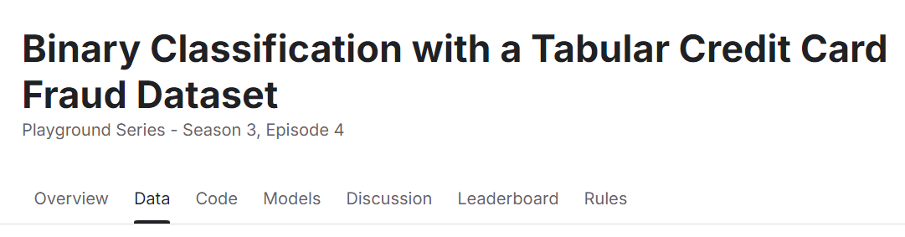
Data
Link: https://www.kaggle.com/competitions/playground-series-s3e4
Variables:
id: A unique identifier for each transaction.
Time: The relative time of the transaction (in seconds), based on the first transaction.
V1~V28: Features transformed through Principal Component Analysis (PCA) to protect sensitive data.
Amount: The transaction amount.
Class: Label that we predict (Class=0:no fraud, otherwise it indicates fraud)

Slide 7
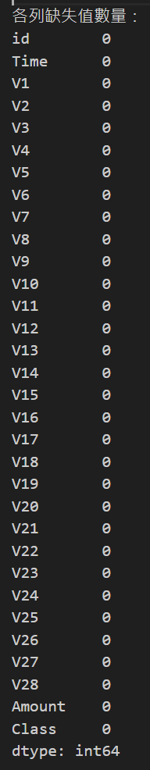
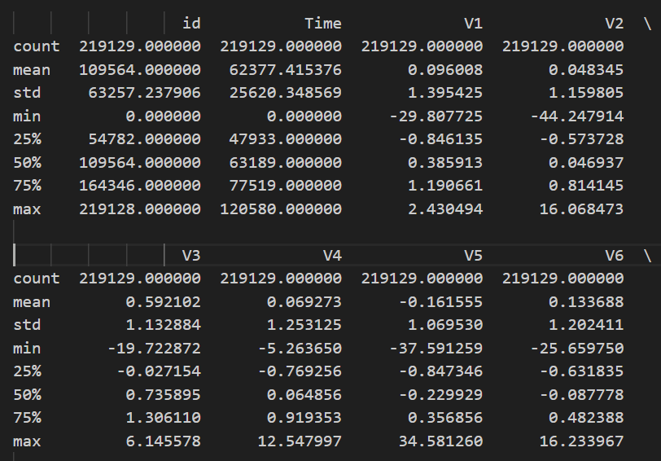
Total transaction datasets:219129

Slide 8
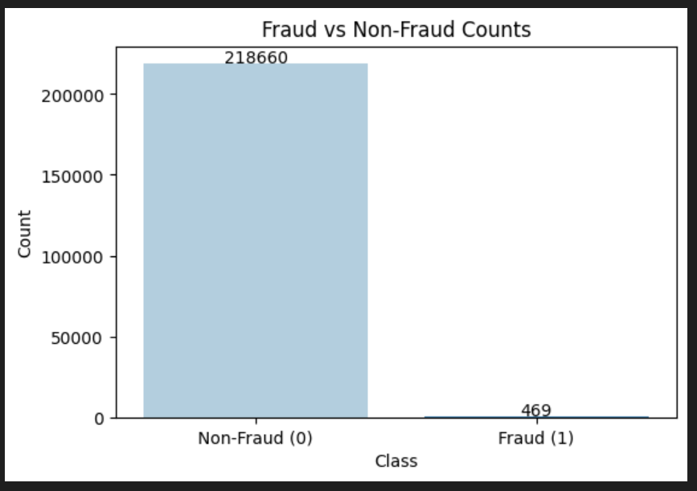
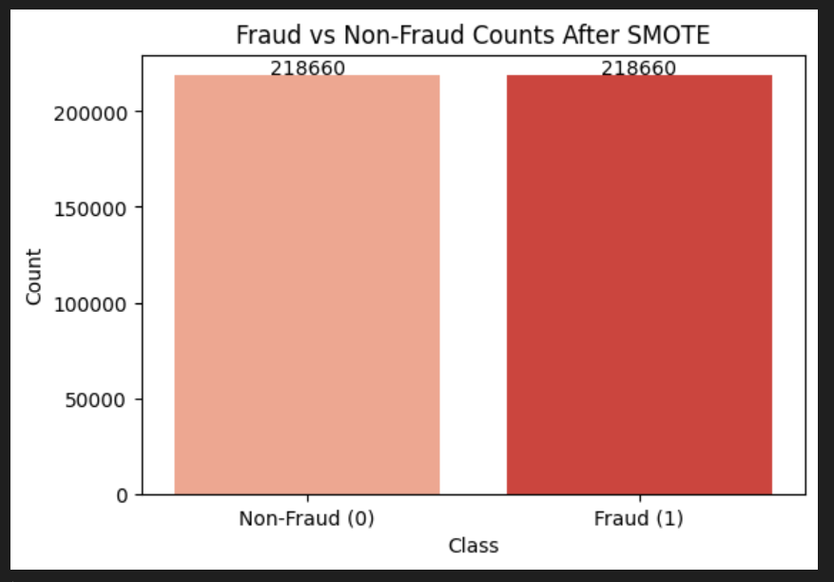
Training data:
SMOTE
→

Slide 9
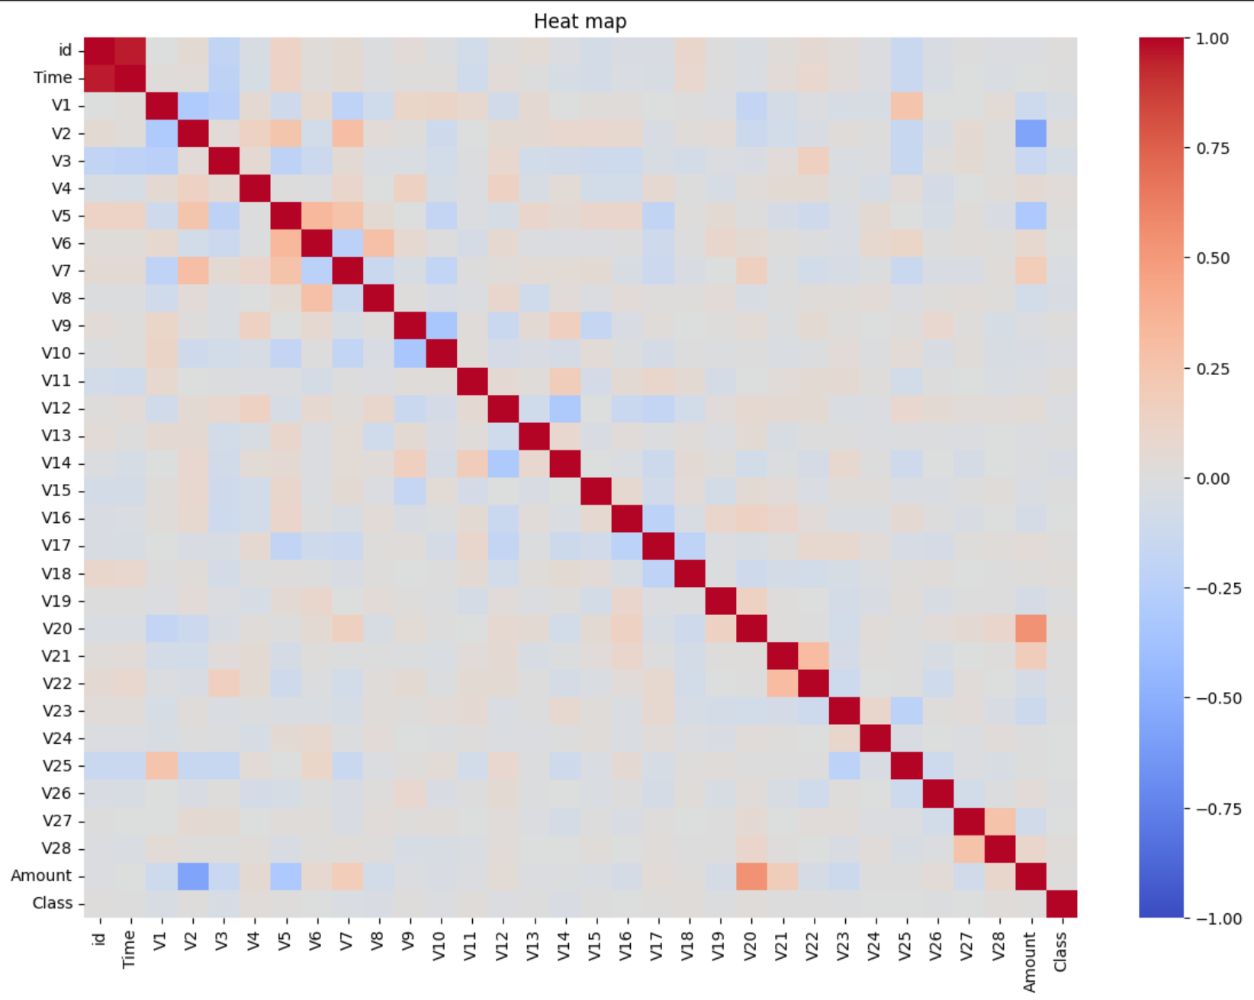

Slide 10
Design of analysis

Slide 11
Motivation
How to do
Model used:Decision tree,RandomForest,XGBoost,KNN
Model | Training set | Testing set
Decision tree | 70% Data (SMOTE method) | 30% Data
RandomForest
XGBoost
KNN
IDA Template

Slide 12
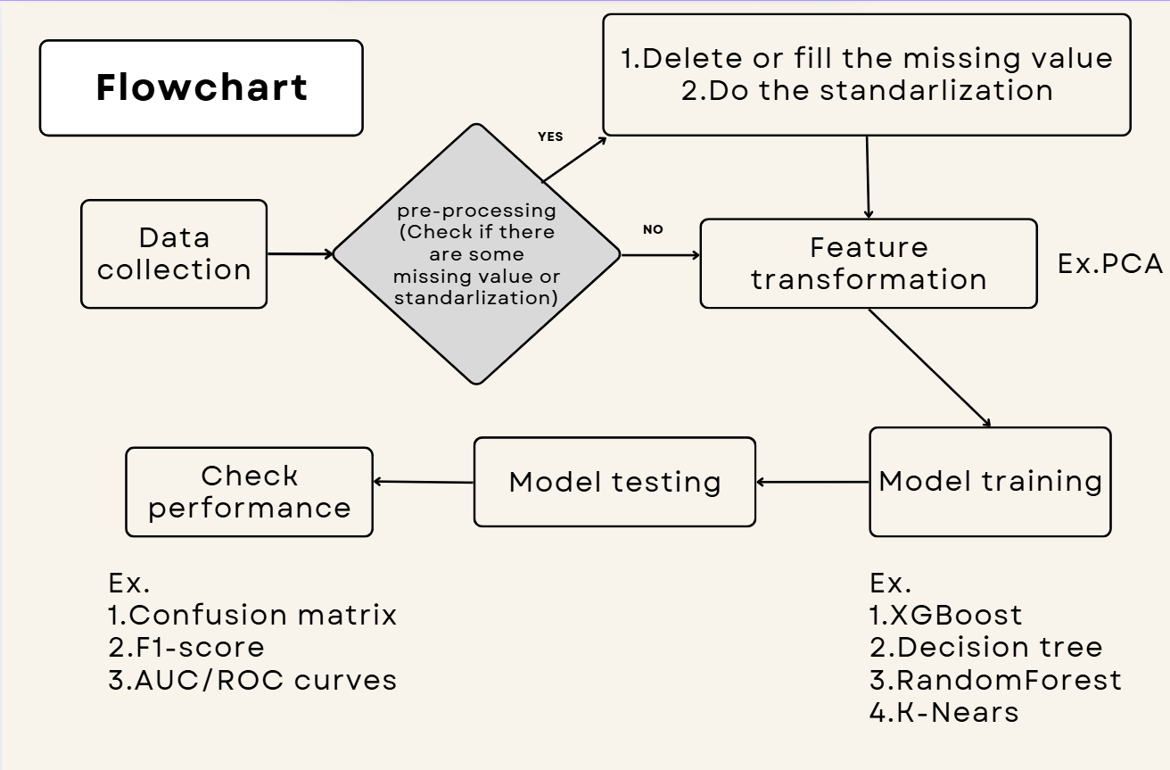

Slide 13
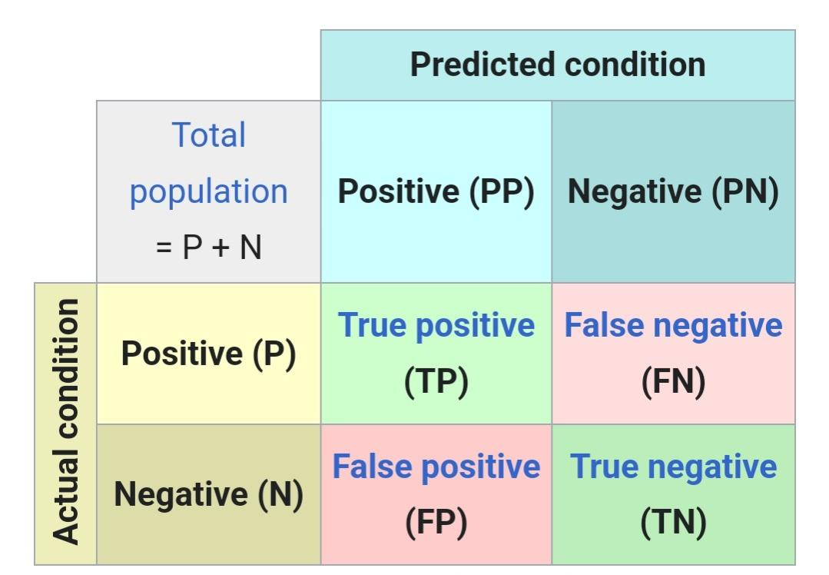
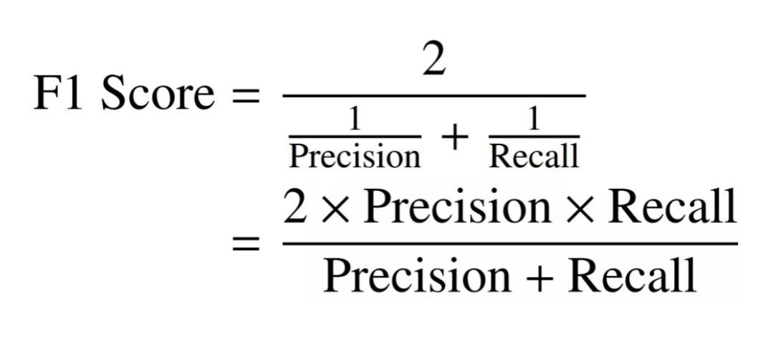
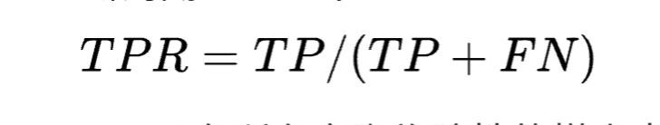
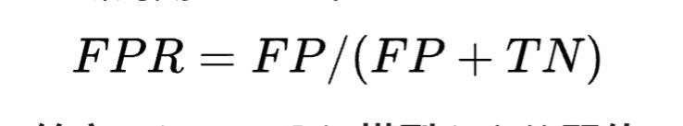
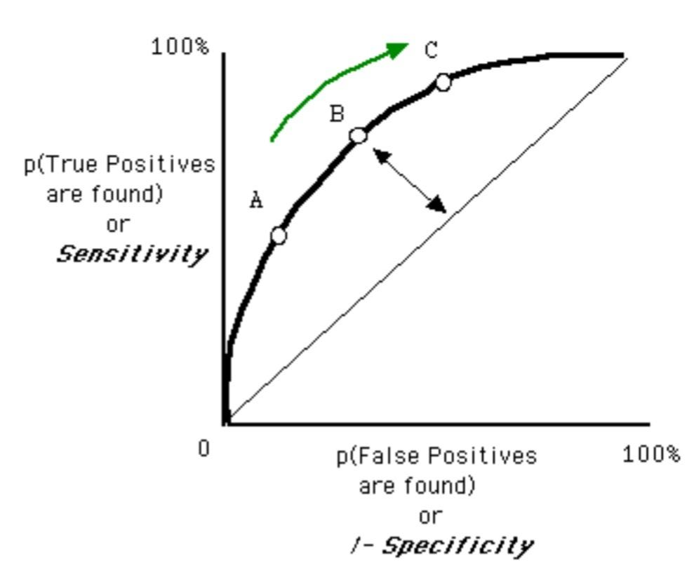
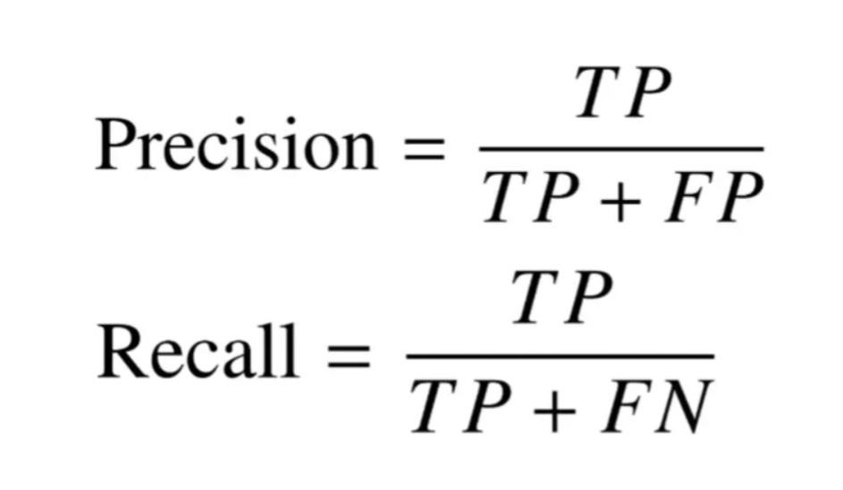
Performance
1.Confusion matrix. 2.F1-score. 3.AUC/ROC curve

Slide 14
Results (No SMOTE)

Slide 15
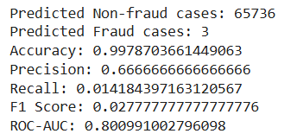
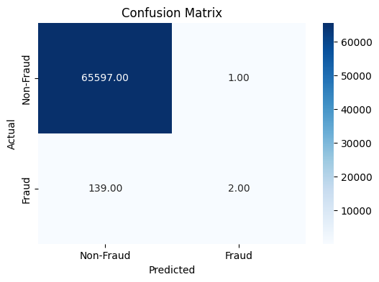
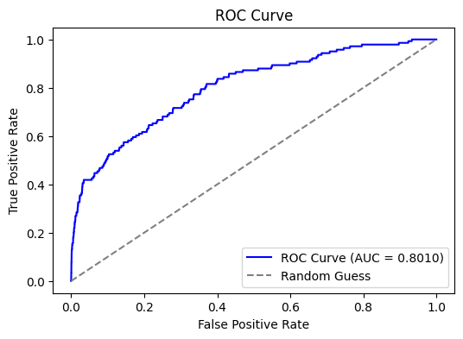
Empirical Results
XGBoost
Evaluation Metrics
IDA Template

Slide 16
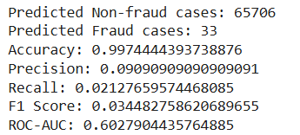

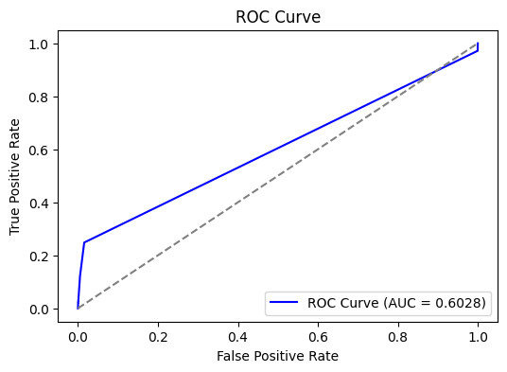
Empirical Results
Decision Tree
Evaluation Metrics
IDA Template

Slide 17
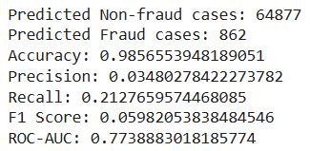

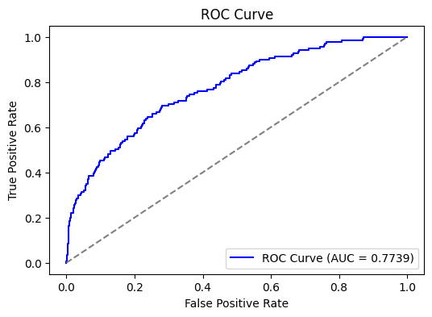
Empirical Results
Random Forest
Evaluation Metrics
IDA Template

Slide 18
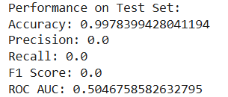
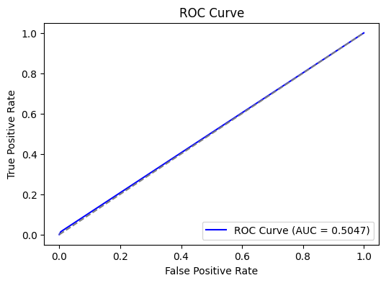

Empirical Results
KNN
Evaluation Metrics
IDA Template

Slide 19
Results (After SMOTE)

Slide 20
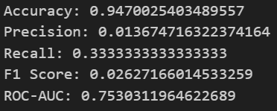
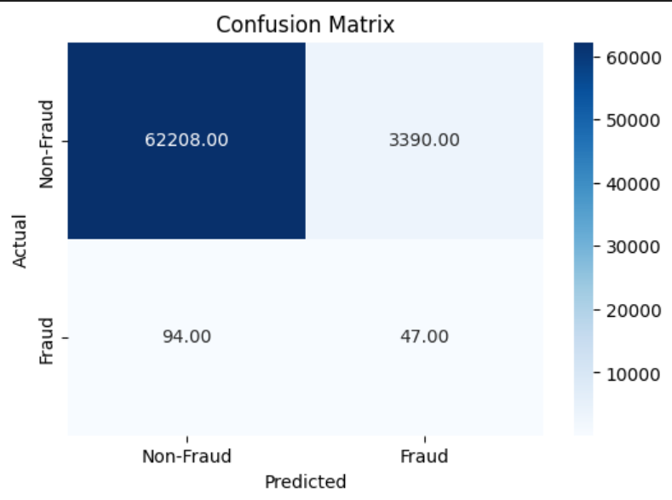
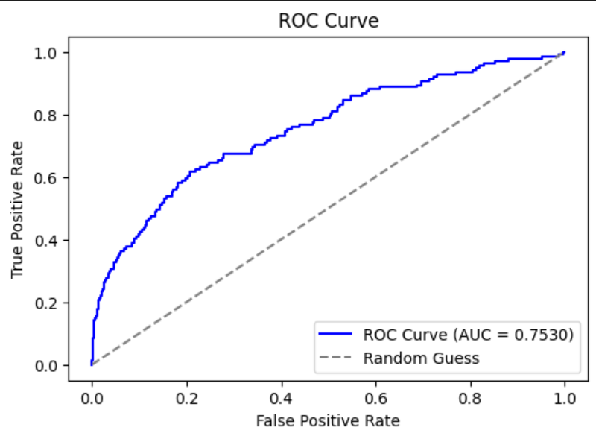
Empirical Results
XGBoost
Evaluation Metrics
IDA Template

Slide 21
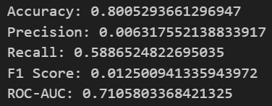

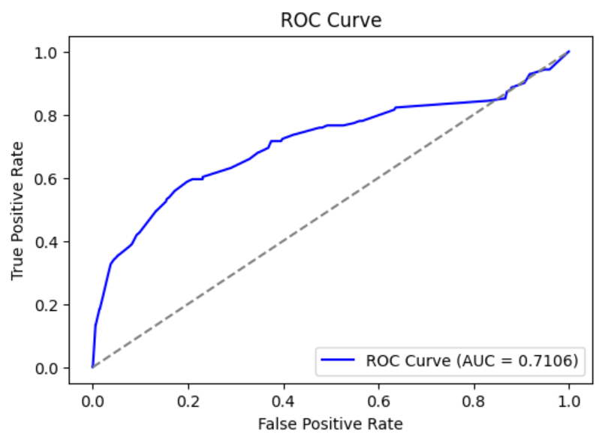
Empirical Results
Decision Tree
Evaluation Metrics
IDA Template

Slide 22
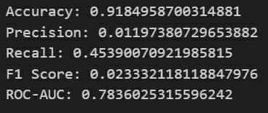
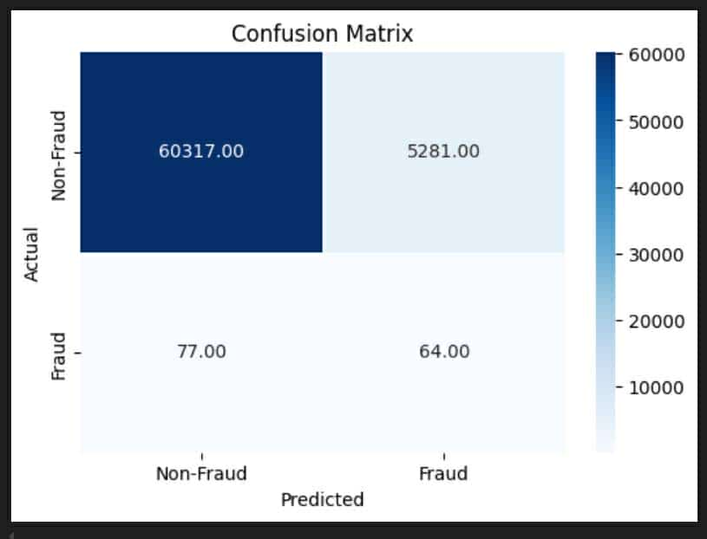
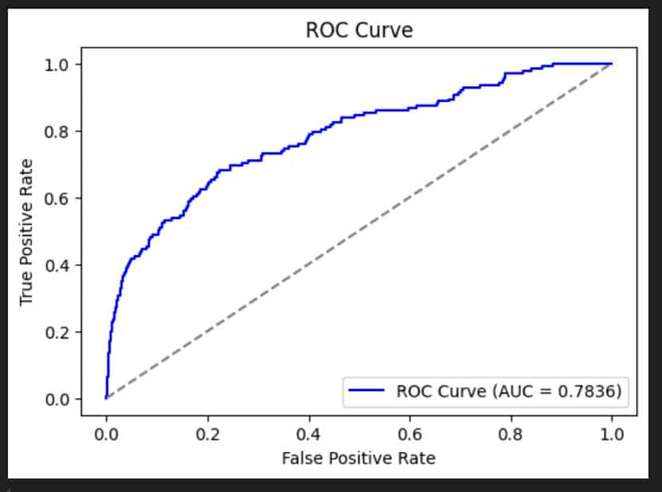
Empirical Results
Random Forest
Evaluation Metrics
IDA Template

Slide 23
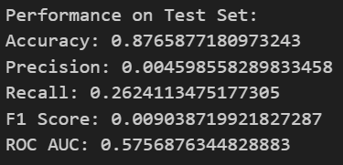

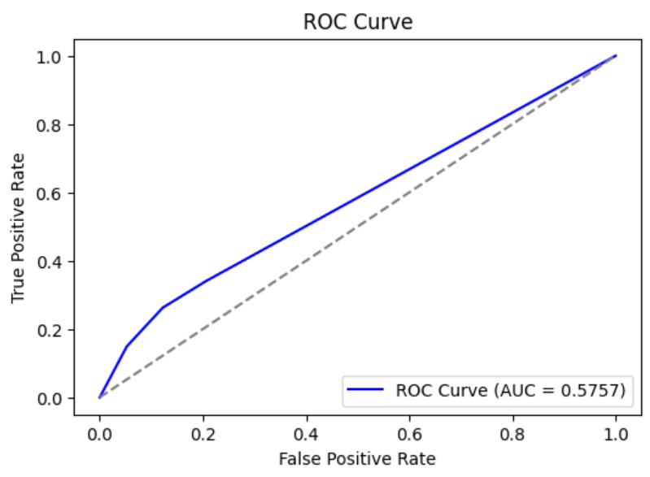
Empirical Results
KNN
Evaluation Metrics
IDA Template

Slide 24
Performance
Conclusion(NO SMOTE)
 | XGBoost | Decision tree | Random forest | KNN
Accuracy | 0.9978 | 0.9974 | 0.9857 | 0.9978
Precision | 0.6666 | 0.0909 | 0.0348 | 0.0
Recall | 0.0142 | 0.2127 | 0.2128 | 0.0
F1 score | 0.0278 | 0.0345 | 0.0598 | 0.0
AUC | 0.8009 | 0.6028 | 0.7739 | 0.5047
IDA Template

Slide 25
Performance
Conclusion(After SMOTE)
 | XGBoost | Decision tree | Random forest | KNN
Accuracy | 0.947 | 0.8005 | 0.9184 | 0.8765
Precision | 0.0136 | 0.0063 | 0.0119 | 0.0046
Recall | 0.3333 | 0.5887 | 0.4539 | 0.2624
F1 score | 0.0262 | 0.0125 | 0.0233 | 0.009
AUC | 0.753 | 0.7105 | 0.7836 | 0.5757
IDA Template

Slide 26
Thanks for listening!

